Slide 1
Letterkenny Army Depot
As of Jan. 2026
VISITORS’ GUIDE
Notes:
Note to presenter: Update Version number, Name, title and Command/Activity Name BEFORE presenting.

Slide 2


VISITOR INFORMATION
ACCEPTABLE TYPES OF IDENTIFICATION FOR DEPOT ACCESS
Primary Identity Source Document
U.S. Passport or a U.S. Passport Card.
Employment Authorization Document that contains a photograph (Form 1-766).
Driver's license or an identification (REAL ID) card issued by a state or possession of the United States provided it contains a photograph.
U.S. Military ID card.
U.S. Military dependent's ID card; or
Personal Identity Verification (PIV) Card.
Secondary Identity Source Document
The secondary identity source document may be from the list above but cannot be the same type as the primary identity source document. An expired Common Access Card {CAC) or Uniformed Services Identification (USID) card may be used as a secondary identity source document for reissuance of the same type of identification card but is not acceptable for initial issuance.
U.S. Social Security Card issued by the Social Security Administration.
Original or certified copy of a birth certificate issued by a state, county, municipal authority, possession, or outlying possession of the United States bearing an official seal.
ID card issued by a federal, state, or local government agency or entity, provided it contains a photograph.
Voter's registration card.
U.S. Coast Guard Merchant Mariner Card.
Certificate of U.S. Citizenship {Form N-560 or N-561).
Certificate of Naturalization (Form N-550 or N-570).
U.S. Citizen ID Card (Form 1-197).
Identification Card for Use of Resident Citizen in the United States (Form 1-179).
Certification of Birth Abroad or Certification of Report of Birth issued by the Department of State (Form FS-545 or Form DS-1350).
ACCESS CONTROL –Visitors to the depot are limited to those persons conducting official business at the depot. Official business visitors should report directly to the ID/CAC Badge Office in Building 2 (refer to map on page 4). The ID/CAC Badge Office hours of operation are 6:45 a.m.-3:45 p.m. Monday through Thursday & 6:45 a.m.- 2:45 p.m. every other Friday. Closed for lunch 11:30 a.m. – 12:00 p.m. daily. Official visitors requesting to drive onto the depot must be in possession of a valid driver’s license (REAL ID), current vehicle registration, automobile insurance card and have a valid vehicle inspection sticker appropriately displayed on the vehicle. The official visitor must provide a depot point of contact while at the ID/CAC Badge Office. For more information, please contact the office at 717-267-8003 or 717-267-8055.
SAFETY INFORMATION –Closed toe/closed low-heel shoes are required in all shop floor production areas. Safety shoes, safety glasses or other protective equipment may be required in other work areas. Contact your Letterkenny Army Depot point of contact for additional information.
PERSONAL ELECTRONIC DEVICES (cell phones, laptops, cameras, etc.) –Personal electronic devices are not permitted in all locations on the depot. Failure to comply with posted personal electronic device restrictions will result in no access granted to that area/building. Contact your Letterkenny Army Depot point of contact for specific information.
PROHIBITED PROPERTY ON LETTERKENNY ARMY DEPOT--
1. ALL FIREARMS AND WEAPONS.
2. ALL PERSONAL PROTECTION ITEMS SUCH AS STUN GUNS,
MACE, TEAR GAS, ETC.
3. EXPLOSIVES IN ANY MANNER OR FORM OR PARTS OF.
4. DRUGS AND/OR DRUG PARAPHERNALIA.
5. ALL PERSONAL ELECTRONIC RADIO EQUIPMENT
NOT APPROVED BY THE FCC.
6. ALCOHOLIC BEVERAGES.
7. PHOTOGRAPHY IS PROHIBITED WITHOUT A LEAD
PHOTO PERMIT. CONTACT YOUR LEAD POC FOR ADDITIONAL INFORMATION.
IMPORTANT DISCLAIMER: This document is provided for informational purposes only. Identification of any commercial entity is not an endorsement by the U.S. Army or Letterkenny Army Depot.

Slide 3
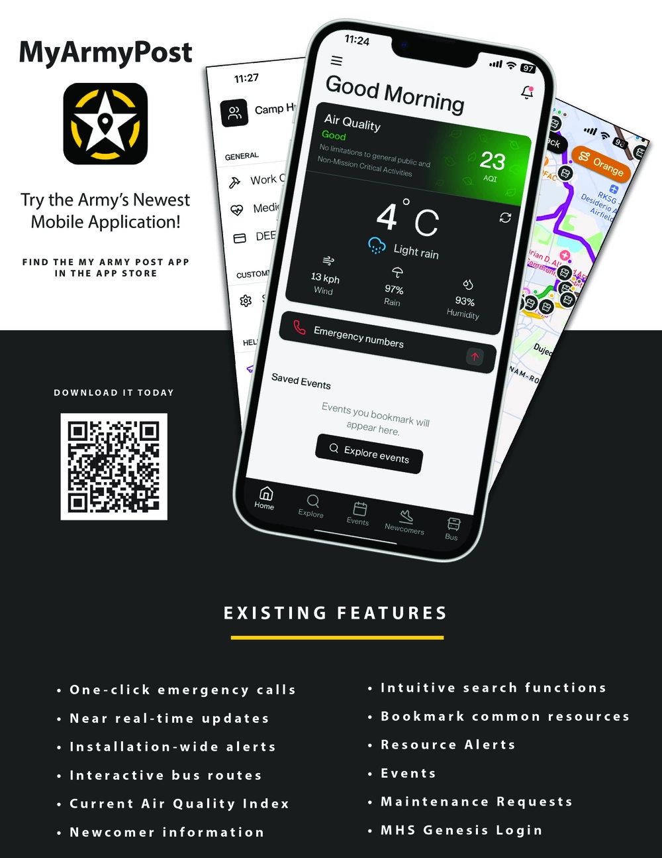


MY ARMY POST APP - MAPA
Stay in the know at LEAD!
Weather: Delays and Closings
Gate Hours
Emergency Numbers
Events
Resources and Information
Directions
IMPORTANT DISCLAIMER: This document is provided for informational purposes only. Identification of any commercial entity is not an endorsement by the U.S. Army or Letterkenny Army Depot.

Slide 4
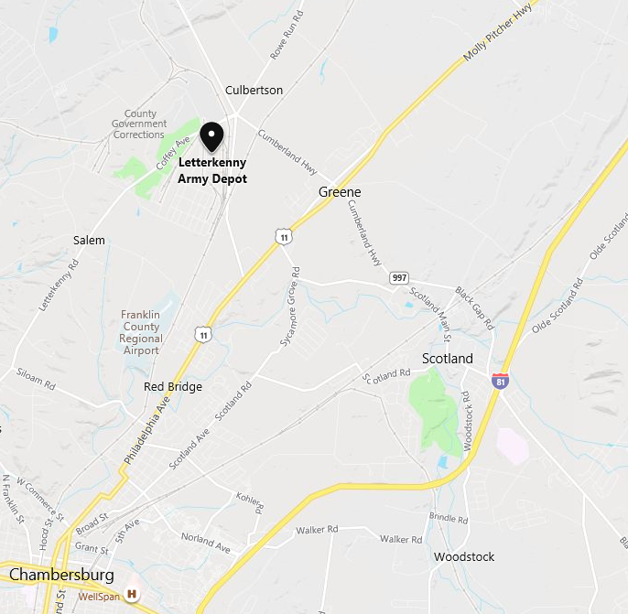
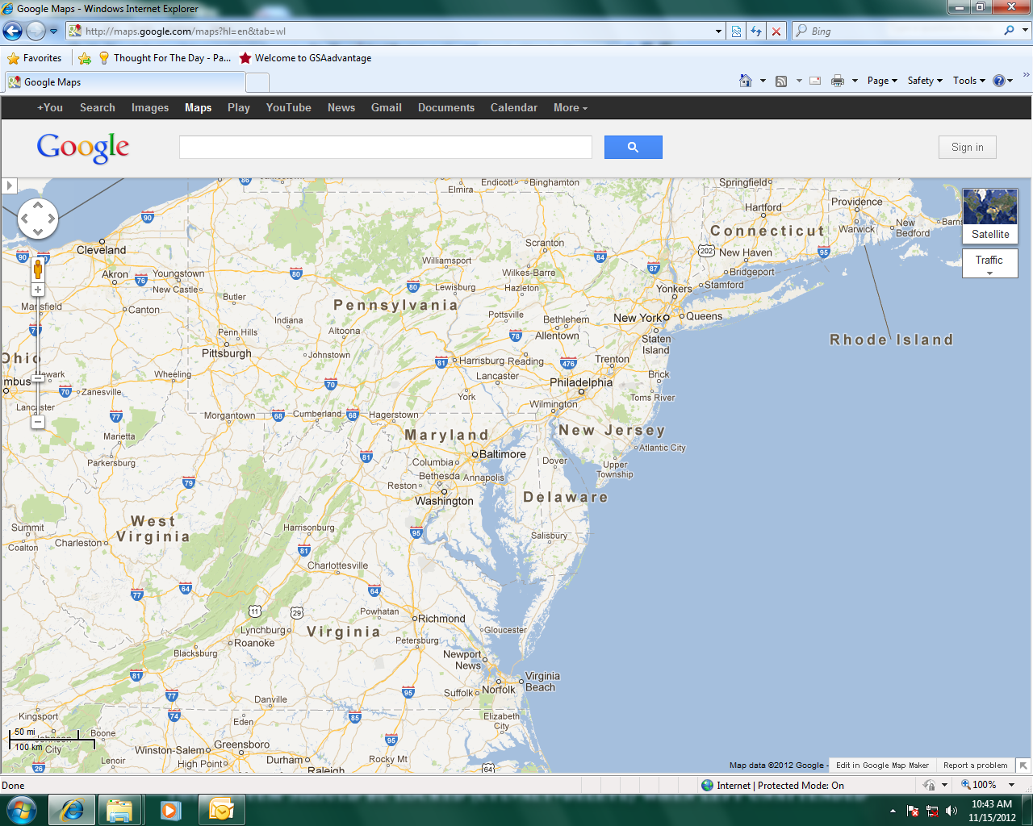
DEPOT MAPS
4 miles from I-81
10 miles from I-76
32 miles from I-70
110 miles from I-95
Exit 20
60 miles southwest
of Harrisburg
105 miles north of Washington, DC
IMPORTANT DISCLAIMER: This document is provided for informational purposes only. Identification of any commercial entity is not an endorsement by the U.S. Army or Letterkenny Army Depot.

Slide 5
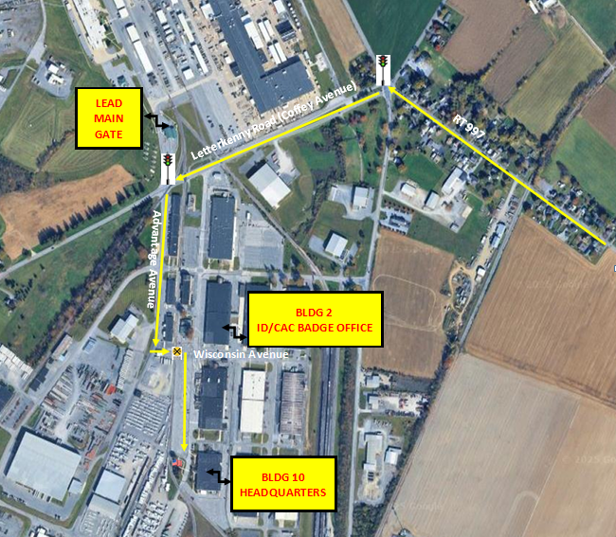
DEPOT MAPS
To LEAD ID/CAC Badge Office (Building 2):
Go to first traffic signal and turn left on to Advantage Ave (do not go to Main Gate).
Proceed straight on Advantage Avenue for approx. .5 miles (you will pass building 11 & 13).
Turn left at Wisconsin Avenue.
Cross the railroad tracks.
Report to Building 2 (on your left) for vetting, badging and directions to your POC’s location
To LEAD Headquarters Building (Building 10):
Go to first traffic signal and turn left on to Advantage Ave (do not go to Main Gate).
Proceed straight on Advantage Avenue for approx. .5 miles (you will pass building 11 & 13).
Turn left at Wisconsin Avenue.
Cross the railroad tracks and immediately turn right into the parking lot.
Proceed straight to the large flag.
Park in the spot marked for Distinguished Visitors in the front row.
Report to the front of Building 10 to meet your POC.
Please use this option ONLY if your VISIT SPONSOR has informed you that you have been pre-vetted and will issue your visitor badges in person upon arrival.
IMPORTANT DISCLAIMER: This document is provided for informational purposes only. Identification of any commercial entity is not an endorsement by the U.S. Army or Letterkenny Army Depot.

Slide 6
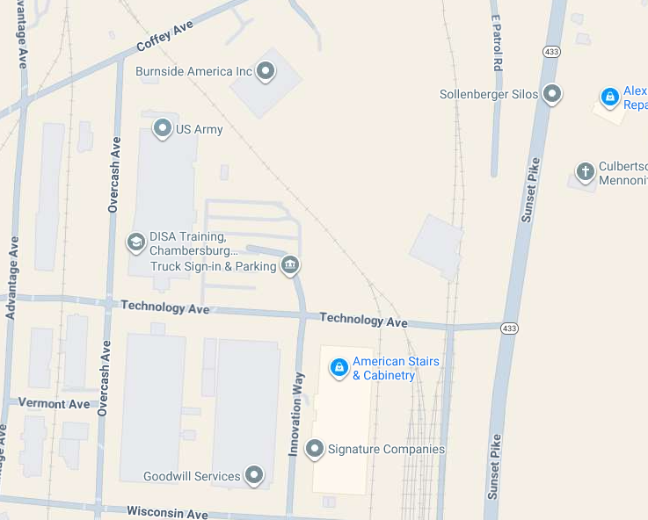

TRUCK DRIVER DELIVERY AND PICK UP
For efficient delivery and pick up, truck drivers shall have a valid driver’s license (REAL ID), vehicle registration and insurance, trailer registration, Bill of Lading, and depot POC. Note: Please refer to slide 2 for other acceptable forms of identification.
NOTE: Deliveries and pick ups are by appointment only, please use the above number to schedule an appointment, if your dispatch has not already set up your appointment. Once your appointment is scheduled, use the below QR code for GPS directions to Technology Gate.
Truck driver delivery and pickup:
Technology Gate, Technology Avenue, Building 1 Parking Lot
Please call 717-267-5220 for concerns or additional directions.
Technology Gate
IMPORTANT DISCLAIMER: This document is provided for informational purposes only. Identification of any commercial entity is not an endorsement by the U.S. Army or Letterkenny Army Depot.

Slide 7

LOCATION
JB McGuire/Dix/Lakehurst AFB, NJ – 192 miles
New York City – 217 miles
Philadelphia, PA – 154 miles
Baltimore, MD – 83 miles
Dover AFB, DE – 180 miles
Norfolk, VA – 291 miles
Charleston, SC – 638 miles
AIRPORTS
(Estimated driving time to LEAD)
Hagerstown Regional Airport, HGR, Hagerstown, MD
30 minutes driving time
Harrisburg International Airport MDT, Harrisburg, PA
1.25 hours driving time Ronald Regan Washington National Airport DCA, Washington DC:
2.25 hours driving time Baltimore/Washington International Thurgood Marshall Airport BWI, Linthicum, MD
2 hours driving time Washington Dulles International Airport, IAD, Dulles, VA
2 hours driving time
IMPORTANT DISCLAIMER: This document is provided for informational purposes only. Identification of any commercial entity is not an endorsement by the U.S. Army or Letterkenny Army Depot.

Slide 8

OVERNIGHT ACCOMMODATIONS
Baymont by Wyndham 1122 Wayne Ave. Chambersburg, PA 17202 717-660-0862 | Hampton Inn 955 Lesher Rd. Chambersburg, PA 17202 717-261-9185 | Main Stay Suites 30 Falling Spring Rd. Chambersburg, PA 17202 717-263-1288 | SpringHill Suites by Marriott 451 Gateway Ave. Chambersburg, PA 17202 717-263-1300
Best Western 211 Walker Rd. Chambersburg, PA 17201 717-262-4994 | Hawthorne Extended Stay by Wyndham 1123 Lincoln Way East Chambersburg, Pa 17201 717-504-8777 | Quality Inn & Suites 1435 Doron Dr. Chambersburg, PA 17201 717-263-0596 | Super 8 by Wyndham 3301 Black Gap Rd. Chambersburg, PA 17202 717-263-6741
Candlewood Suites 231 Walker Rd. Chambersburg, PA 17201 717-263-2800 | Holiday Inn Express Hotel & Suites 1097 Wayne Ave. Chambersburg, PA 17201 717-709-9009 | Red Carpet Inn 1175 Wayne Ave. Chambersburg, PA 17202 717-267-2323 | Travelodge by Wyndham 565 Lincoln Way East Chambersburg, PA 17201 717-264-4187
Comfort Inn 3648 Olde Scotland Rd. Chambersburg, PA 17202 717-706-6142 | The Inn at Ragged Edge 1090 Ragged Edge Rd. Chambersburg, PA 17202 717-496-8372 | Red Roof Inn 1110 Shellar Ave. Chambersburg, PA 17201 717-264-8382 | Tru by Hilton 101 Walker Rd. Chambersburg. PA 17201 717-261-9792
Country Inn and Suites by Radisson 399 Beddington Boulevard Chambersburg, PA 17201 717-261-0900 | La Quinta Inn & Suites by Wyndham 199 Walker Rd. Chambersburg, PA 17201 717-446-0770 | Sleep Inn 30 Falling Spring Road, Chambersburg, PA 17201 717-263-1288
This listing represents only a small portion of overnight accommodations in the Letterkenny Army Depot area and is intended for reference only.
An expanded listing of lodging in Franklin County may be found by visiting Explore Franklin County’s, “ Do, Dine and Stay” section of the organization's website at:
https://dodinestay.com/listing-category/stay/
Visitors should inquire directly with the hotel regarding federal government per diem rates.
IMPORTANT DISCLAIMER: This document is provided for informational purposes only. Identification of any commercial entity is not an endorsement by the U.S. Army or Letterkenny Army Depot.

Slide 9

LOCAL DINING
Aki Steakhouse and Sushi Bar
424 Gateway Avenue
Chambersburg, PA 17201
717-263-9393
Benny’s Italian Restaurant
1910 Lincoln Way E
Chambersburg, PA 17202
71-263-0422
Big Oak Café
410 Stouffer Avenue
Chambersburg, PA 17201
717-262-2446
Bistro 71
71 North Main Street
Chambersburg, PA 17201
717-261-0007
Brothers Pizza
1643 Lincoln Way East
Chambersburg, PA 17202
717-264-4567
Café Del Sol
438 Gateway Avenue
Chambersburg, PA 17201
717-261-1805
Caretti’s Pizza
2625 Philadelphia Avenue
Chambersburg, PA 17201
717-263-9553
and
1710 Lincoln Way East
Chambersburg, PA 17202
717-264-3390
Ciao Bella
6418 Chambersburg Road
Fayetteville, PA 17222
717-352-3998
Chambersburg Family Diner
1110 Lincoln Way E
Chambersburg, PA 17201
717-446-0275
Copper Kettle
1049 Lincoln Way East
Chambersburg, PA 17201
717-264-3109
The Cottage Pub & Restaurant
572 Wayne Avenue
Chambersburg, PA 17201
717-264-8543
J&A’s Pizza
5201 Coffey Avenue
Chambersburg, PA 17201
717-261-2110
Giacomo’s Italian Restaurant
107 Mont Alto Road
Fayetteville, PA 17222
717-352-0199
Greenvillage Drive-In Family Restaurant
5440 Philadelphia Avenue
Chambersburg, PA 17202
717-263-5774
Hickory Ridge Restaurant
3875 Philadelphia Ave
Chambersburg, PA 17202
717-552-2734
Inka Kitchen-Pollo-A-La Brasa
811 Wayne Avenue
Chambersburg, PA 17202
717-491-1833
Italian Village Restaurant
5267 Philadelphia Avenue
Chambersburg, PA 17202
717-264-8577
This listing represents only a small portion of restaurants in the Letterkenny Army Depot area and is intended for reference only.
An expanded listing of local restaurants in Franklin County may be found by visiting Explore Franklin County’s, “Do, Dine and Stay” section of the organization's website at:
https://dodinestay.com/listing-category/dine/
IMPORTANT DISCLAIMER: This document is provided for informational purposes only. Identification of any commercial entity is not an endorsement by the U.S. Army or Letterkenny Army Depot.

Slide 10
LOCAL DINING
Johnnie’s Family Restaurant
679 South Main Street
Chambersburg, PA 17201
717-263-2334
Kenzo Japanese & Asian Fusion
1495 Lincoln Way East –Suite 108
Chambersburg, PA 17202
717-263-0076
Korean Bulgogi House
408 West Loudon Street
Chambersburg, PA 17201
717-263-0419
Mario’s Italian Restaurant
831 Wayne Avenue
Chambersburg, PA 17201
717-263-9397
Montezuma Mexican Restaurant
1495 Lincoln Way East #103
Chambersburg, PA 17201
717-263-6600
and
820 Wayne Avenue
Chambersburg, PA 17201
717-709-1003
New Texas Lunch Family Restaurant
108 Lincoln Way West
Chambersburg, PA 17201
717-264-4439
Norland Pub
454 Norland Avenue
Chambersburg, PA 17201
717-264-9115
The Orchards
1580 Orchard Drive
Chambersburg, PA 17201
717-264-4711
Pat & Carla’s Italian Eatery
600 Lincoln Way East
Chambersburg, PA 17201
717-263-6353
Relax Lounge at the Orchards
1580 Orchard Drive
Chambersburg, PA 17201
717-264-4711
Rosalie’s Fabulous Grill
1901 Scotland Avenue
Chambersburg, PA 17201
717-262-4981
Stoner’s Family Restaurant
615 Wayne Ave
Chambersburg, PA 17201
717-263-2008
This listing represents only a small portion of restaurants in the Letterkenny Army Depot area and is intended for reference only.
An expanded listing of local restaurants in Franklin County may be found by visiting Explore Franklin County’s, “Do, Dine and Stay” section of the organization's website
at:
https://dodinestay.com/listing-category/dine/
IMPORTANT DISCLAIMER: This document is provided for informational purposes only. Identification of any commercial entity is not an endorsement by the U.S. Army or Letterkenny Army Depot.

Slide 11
THINGS TO DO
MOVIE THEATERS
Leitersburg Cinemas
20145 Leitersburg Pike
Hagerstown, MD 21740
240-608-4900
Regal Valley Mall
17301 Valley Mall Road
Hagerstown, MD 21740
844-462-7342
GOLF COURSES
Penn National Golf Club & Inn
18-hole golf course
3720 Club House Dr.
Fayetteville, PA 17222
717-352-2400
Conocodell Golf Club
nine-hole golf course
112 Coldspring Rd
Fayetteville, PA 17222
717-352-3222
Caledonia Golf Club
18-hole golf course
9515 Golf Course Road
Fayetteville, PA 17222
717-352-7271
FITNESS CENTERS
Alpha Fitness
100 Sunset Boulevard W.
Chambersburg, PA 17201
717-261-0077
Chambersburg Fitness Center
810 Wayne Ave
Chambersburg, PA 17201
717-267-2291
Chambersburg YMCA
570 East McKinley Street
Chambersburg, PA 17201
717-263-8508
Planet Fitness
1695 Lincoln Way East
Chambersburg, PA 17202
717-261-9980
WellSpan Results Fitness
1600 Orchard Drive
Chambersburg, PA 17201
This listing represents only a small portion of things to do in the Letterkenny Army Depot area and is intended for reference only.
An expanded listing of local things to do in Franklin County may be found by visiting Explore Franklin County’s, “ Do, Dine and Stay” section of the organization's website at:
https://dodinestay.com/listing-category/do/
AMUSEMENT CENTER
Cluggy’s Family Amusement Center
393 Beddington Blvd
Chambersburg, PA 17201
717-267-3772
Fun Castle Fun Center
3054 Buchanan Trail East
Greencaslte, PA 17225
717-593-9621
IMPORTANT DISCLAIMER: This document is provided for informational purposes only. Identification of any commercial entity is not an endorsement by the U.S. Army or Letterkenny Army Depot.

Slide 12
MEDICAL FACILITIES
HOSPITAL
WellSpan Chambersburg Hospital
112 N 7th Street
Chambersburg, PA 17201
717-267-3000
Hours: Open 24 Hours
URGENT CARE FACILITIES
WellSpan Urgent Care
1000 Norland Avenue
Chambersburg, PA 17201
717-267-6363
Hours: Monday – Sunday – 8:00 am – 8:00 pm
Keystone Urgent Care
111 Chambers Hill Drive, Suite 100
Chambersburg, PA 17201
717-709-7979
Hours: Monday – Sunday – 7:00 am – 7:00 pm
Keystone Urgent Care – Catherine Street
133 W Catherine Street, Suite 100
Chambersburg, PA 17201
717-261-4933
Hours: Monday – Friday – 7:00 am – 7:00 pm
This listing represents only a small portion of medical facilities in the immediate area and is intended for reference only.
An expanded listing of healthy living may be found by visiting Explore Franklin County’s, Healthy Living in PA’s section of the organization's website at:
https://www.explorefranklincountypa.com/healthy-living-in-franklin-county-pa/
IMPORTANT DISCLAIMER: This document is provided for informational purposes only. Identification of any commercial entity is not an endorsement by the U.S. Army or Letterkenny Army Depot.

Slide 13

IMPORTANT CONTACTS
ID/CAC Badge Office (717) 267-8751 - Appointment Only - Provides CAC/MILITARY IDs Updates - (DEERS) Defense Enrollment Eligibility Reporting System | Public Affairs Office (717) 267-5482 Email PA Office: usarmy.letterkenny.usamc.list.public-affairs-office@army.mil Please allow up to 48 hours for all media inquiry responses.
Police, Fire, Ambulance, Emergency: 911 (Franklin County Dispatch) * *Advise that you are on Letterkenny Army Depot Property. LEAD Police Desk: 717-267-8800 | Protocol Office (717) 267-9741 Email Protocol Office: usarmy.letterkenny.usamc.mbx.protocol@army.mil Please allow up to 48 hours for all media inquiry responses.
Letterkenny Army Depot (Information) (717) 267-8111 | EEO Office (717) 267-5427
Letterkenny Army Depot status (717) 267-8109 or (717) 267-8916 | LEAD Quality Hotline: (717) 267-9693
DOIM Technical / Hardware support Monday - Friday: 0600-1700 (717) 267-8000 | Letterkenny Army Depot US Army Occupational Health Clinic (717) 267-8017 FAX (717) 267-5365
Hunting & Fishing Status Natural Resources Office hotline: (717) 267-8200 Licensing & Other inquiries: (717)-267-8674 | Sexual Assault Hotline (240) 674-2802
Truck Driver Hotline Number (717) 267-5220 | LEAD Law Enforcement Division (717) 267-8800
Union Office NFFE 1429 (717) 267-5286 | Union Office NFFE 1442 (717) 267-4040 or (717) 267-5819
IMPORTANT DISCLAIMER: This document is provided for informational purposes only. Identification of any commercial entity is not an endorsement by the U.S. Army or Letterkenny Army Depot.

Slide 14


INTERACTIVE CUSTOMER EVALUATION (ICE)
Welcome to Letterkenny Army Depot! You can rate your experience here and provide us with valuable feedback using the Interactive Customer Evaluation (ICE) website. Please scan the QR code below or click the URL link provided.
https://ice.disa.mil/index.cfm?fa=site&site_id=663
IMPORTANT DISCLAIMER: This document is provided for informational purposes only. Identification of any commercial entity is not an endorsement by the U.S. Army or Letterkenny Army Depot.

